Slide 1




BTech Project SEM V
Smart
Waste Segregation System.
Project Supervisor:
Dr. Nagendra Kushwaha
Omkar Bharitkar
112016020
Himanshu Agrawal
112016001

Slide 2
Report Outline
PART 1
Introduction
PART 2
Problem Statement
PART 3
Objectives.
PART 4
Proposed Solution.
PART 5
Technologies Used
PART 6
Circuits
02

Slide 3

Introduction
A waste Segregation System is an intelligent device that segregates waste into dry and wet sections which helps households and also corporation of cities to manage the trash correctly.
03

Slide 4

Problem Statement
In the current scenario, waste is not been segregated (Dry and Wet) in the maximum number of households and public places.
The maximum percentage of trash is in mixed form.
Waste is not being able to recycle/decompose.
The requirement for landfills is increasing day by day.
04

Slide 5



Objectives
POINT 1
To prevent the mixing of garbage.
POINT 2
To ease the life of the user by automatically segregating the waste.
POINT 3
To reduce the amount of trash that remains waste and is dumped into landfills.
05

Slide 6

Proposed Solution
We aim to create a Smart Garbage Collection System that separates the trash by itself and store it in different wet and dry compartment indirectly it will help in the recycling/decomposition of trash and reduce the amount of trash that remains waste at the end.
“Waste isn’t waste until we waste it.”
06

Slide 7
Technologies Used.
1
ARDUINO UNO :- ARDUINO UNO IS A EASY-TO-USE PROGRAMMABLE OPEN-SOURCE MICROCONTROLLER BOARD. IT IS THE DEVICE WHICH CONTROLS AND OPERATES THE WORKING OF SENSORS AND MOTOR.
2
IR SENSOR :- AN INFRARED SENSOR IS AN ELECTRONIC DEVICE, THAT EMITS IN ORDER TO SENSE SOME ASPECTS OF THE SURROUNDINGS. THIS SENSOR CAN DETETCT THE HEAT AS WELL AS THE MOTION OF THE OBJECT.
3
SERVO MOTOR:- SERVO MOTORS ARE ELECTRONIC DEVICES AND ROTARY OR LINEAR ACTUATORS THAT ROTATE AND PUSH PARTS OF A MACHINE WITH PRECISION. IN THIS CASE IT WILL ROTATE ON INPUT 1 AND INPUT 0 IN DIFFERENT DIRECTIONS.
07

Slide 8
Technologies Used.
4
MOISTURE SENSOR :- MOISTURE SENSOR IS ABLE TO DETECT WHETHER THE GIVEN OBJECT HAS MOISTURE OR NOT. IN THIS CASE IT WILL GIVE OUTPUT 1 IF IT IS MOIST AND OUTPUT 0 IF IT IS NOT MOIST.
5
SOFTWARES USED:- ARDUINO IDE, TINKERCAD.
"Internet of Things has the potential to change the world"
08

Slide 9
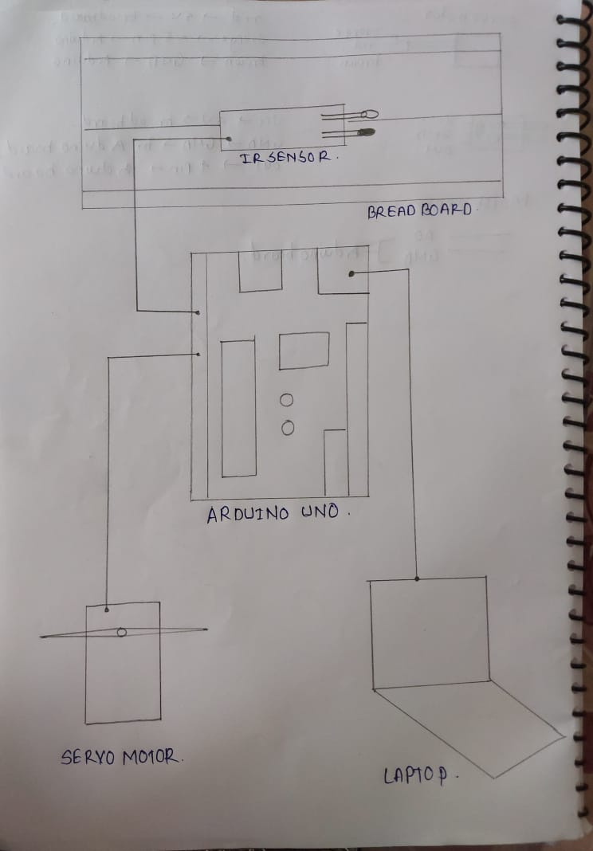
CIRCUIT
DIAGRAM.
09

Slide 10
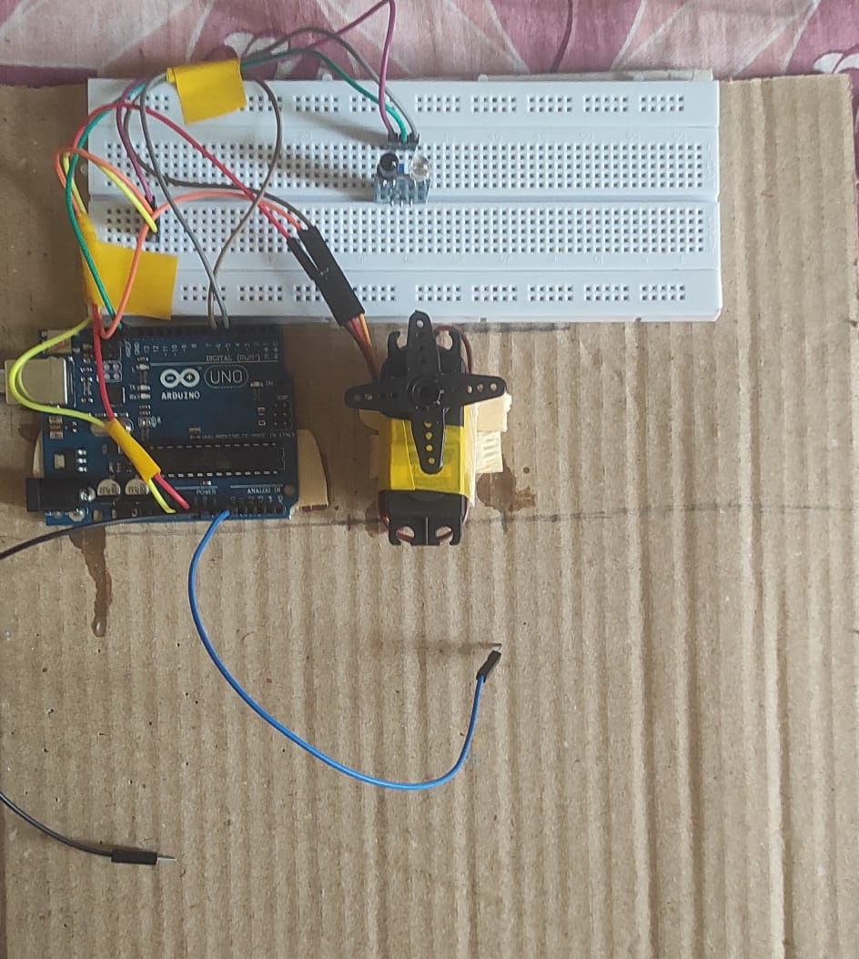
PROPOSED
CIRCUIT.
10

Slide 11
BTech Project SEM V
Thankyou!
Omkar Rajendra Bharitkar.
112016020 ECE.
omkarbharitkar20@ece.iiitp.ac.in
Himanshu Sushil Agrawal.
112016001 ECE.
himanshuagrawal20@ece.iiitp.ac.in
Smart
Waste Segregation System.

